Slide 1
Accelerate Delaware
Team 13

Slide 2
goals
Create a social media platform tailored towards connecting young millennials with professionals
Profile for individuals
Create social connections through organizations, restaurants, parks, etc. that hold events
Profile for event organizations

Slide 3
Profile interface
Location services (GPS)
Networking and social media
Calendar of events
Invites
Promotions and saved offers
Point system

Slide 4
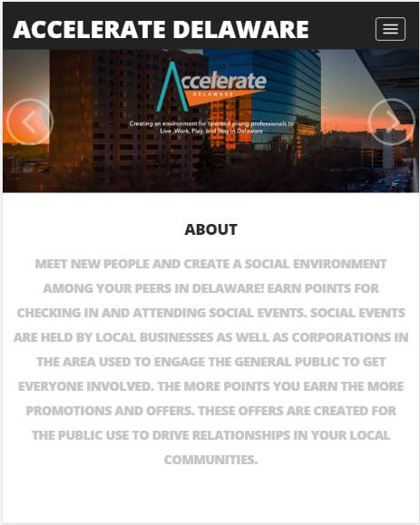
Welcome Screen
Logo
Login
About

Slide 5
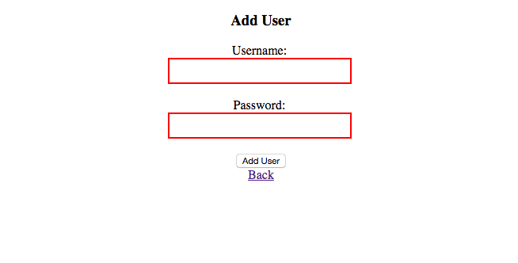
Registration Screen
Register account
Store in users file

Slide 6
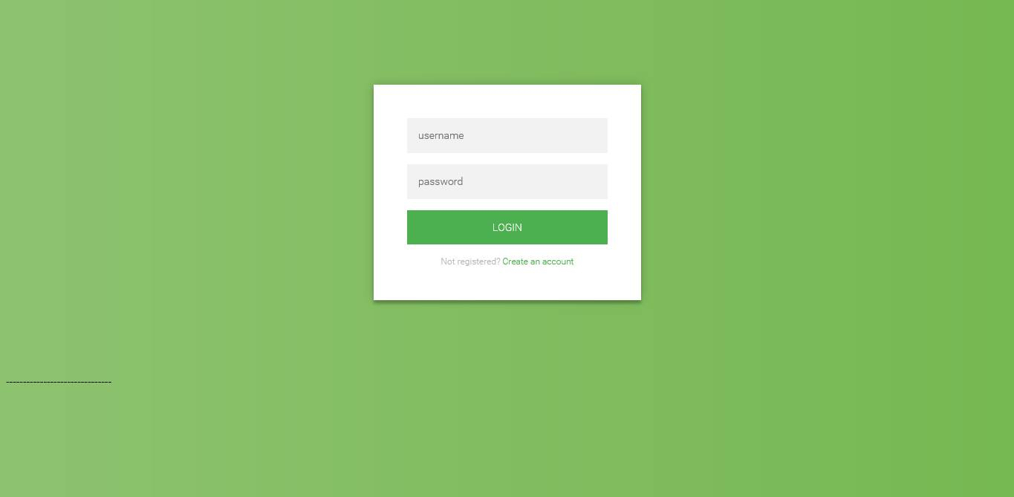
Login Screen
Log into account
Sign in with Facebook and/or other social media

Slide 7
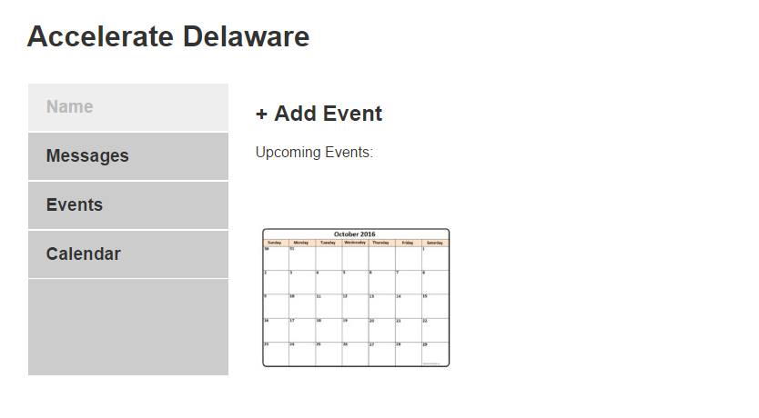
Opening Screen
Dashboard of events
Calendar

Slide 8
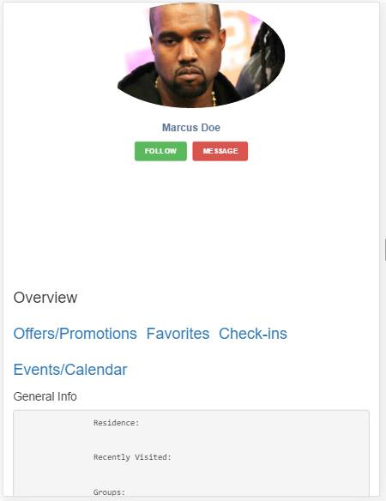
Profiles
User profile
Specialized for user

